Slide 1
Virtual Memory
8 Frames
2015-03-12

Slide 2
Two-Level Paging System
Paging
Virtual Address
15 … 11 10 … 6 5 … 0
RPTE #
UPTE #
Frame Offset
Root Page Table
User Page Table
LC-3 Main Memory
+
Flags / Frame #
Flags / UPT #
+
Frame<<6
Offset
15 … 6 5 … 0
RPT
One per process
Physical Address

Slide 3
Virtual Memory
Project 4
x0000
System
(unmapped)
Virtual Address
x2000
Non-Swappable
Frames
All tables in LC-3 memory.
All memory accesses thru getMemAdr().
RPT’s pinned.
Each process has an RPT pointer (changed on context switch).
Memory limit set by IM command.
x2400
Bit Frame Table
RPT’s (Pinned)
x3000
UPT Frames
and
Data Frames
Swappable
Frames
Paged
Swap
Space
Memory Limit
(IM command)
Unpopulated
Memory
xFFFF
Notes:
3

Slide 4
Page Table Entry
Project 4
4 bytes
 |  |  |  |  |  | Frame # (0 – 1023)
F | D | R | P | - | - | f | f | f | f | f | f | f | f | f | f
 |  |  |  | Page # (0 – 8191)
S | - | - | p | p | p | p | p | p | p | p | p | p | p | p | p
• Frame valid (1 bit): one if referenced frame is in main memory; zero otherwise.
• Dirty (1 bit): one if referenced frame has been altered; zero otherwise.
• Reference (1 bit): one if frame has been referenced; zero otherwise.
• Pinned (1 bit): one if frame is pinned in memory; zero otherwise.
• Frame number (10 bits): If referenced page is in memory, this value specifies which frame it occupies. (1024 frames × 64 words = 2¹⁰ × 2⁶ = 2¹⁶ bytes = 65536 words.)
• Swap valid (1 bit): one if referenced page has been allocated in swap space; zero otherwise.
• Swap page number (13 bits). This specifies where referenced page is stored in swap space. When you load a page into memory, you should include this value in your frame table summary. (8,192 pages × 128 bytes = 2¹³ × 2⁷ = 2²⁰ bytes = 1,048,576 bytes.)
Notes:
4

Slide 5
Virtual to Physical Address
Project 4
memory[tcb[curTask].rpt + ((((va)&0xf800)>>11)<<1)]
memory[(rpte1&0x03ff)<<6+((((va)&0x7c0)>>6)<<1)]
&memory[(upte1&0x03ff)<<6+((va)&0x003f)]
rpte1 = memory[tcb[curTask].rpt + RPTI(va)];
upte1 = memory[(FRAME(rpte1)<<6) + UPTI(va)];
&memory[(FRAME(upte1)<<6) + FRAMEOFFSET(va)];

Slide 6
Global Clock
Project 4
Swap Space
RPTE’s
UPTE’s
Data Frame’s
Notes:
6

Slide 7
8 Frame Exercise

Slide 8
VM Exercise (8 Frames)…
Project 4
FR____|S____
x3000
(192)
Frame
Page
Virtual
Address
Physical
Address
x2400
RPT0
00____|0____
00____|0____
00____|0____
00____|0____
00____|0____
00____|0____
00____|0____
00____|0____
...
00____|0____
00____|0____
00____|0____
00____|0____
00____|0____
x0000–x07FF
x0800–x0FFF
x1000–x17FF
x1800–x1FFF
x2000–x27FF
x2800–x2FFF
x3000–x37FF
x3800–x3FFF
...
xD800–xDFFF
xE000–xE7FF
xE800–xEFFF
xF000–xF7FF
xF800–xFFFF
x3040
(193)
x3080
(194)
x30C0
(195)
x3100
(196)
x2440
RPT1
00____|0____
00____|0____
00____|0____
00____|0____
...
x3140
(197)
x3180
(198)
x31C0
(199)
x3200

Slide 9
VM Exercise (8 Frames)…
Project 4
FR____|S____
x3000
(192)
Frame
Page
00____|0____
00____|0____
...
00____|0____
x3000–x303F
x3040–x307F
...
x3780–x37FF
Virtual
Address
Physical
Address
x2400
RPT0
11_193
00____|0____
00____|0____
00____|0____
00____|0____
00____|0____
00____|0____
00____|0____
00____|0____
...
00____|0____
00____|0____
00____|0____
00____|0____
00____|0____
x0000–x07FF
x0800–x0FFF
x1000–x17FF
x1800–x1FFF
x2000–x27FF
x2800–x2FFF
x3000–x37FF
x3800–x3FFF
...
xD800–xDFFF
xE000–xE7FF
xE800–xEFFF
xF000–xF7FF
xF800–xFFFF
0x3000
⇒ 0x3040
x3040
(193)
0x3001
⇒ 0x3041
x3000-x303F
Data Frame
x3080
(194)
x240C
11_192
x30C0
(195)
x3100
(196)
x2440
RPT1
00____|0____
00____|0____
00____|0____
00____|0____
...
x3140
(197)
x3180
(198)
x31C0
(199)
x3200

Slide 10
VM Exercise (8 Frames)…
Project 4
FR____|S____
x3000
(192)
Frame
Page
11_193|0____
00____|0____
...
00____|0____
Virtual
Address
Physical
Address
x2400
RPT0
00____|0____
00____|0____
00____|0____
00____|0____
00____|0____
00____|0____
11_192|0____
00____|0____
...
00____|0____
00____|0____
00____|0____
00____|0____
00____|0____
11_194
x0000–x07FF
x0800–x0FFF
x1000–x17FF
x1800–x1FFF
x2000–x27FF
x2800–x2FFF
x3000–x37FF
x3800–x3FFF
...
xD800–xDFFF
xE000–xE7FF
xE800–xEFFF
xF000–xF7FF
xF800–xFFFF
0x3000
⇒ 0x3040
x3040
(193)
0x3001
⇒ 0x3041
x3000-x303F
Data Frame
0x3040
⇒ 0x3080
0x3041
⇒ 0x3081
x3080
(194)
x3040-x307F
Data Frame
x30C0
(195)
x3100
(196)
x2440
RPT1
00____|0____
00____|0____
00____|0____
00____|0____
...
x3140
(197)
x3180
(198)
x31C0
(199)
x3200

Slide 11
VM Exercise (8 Frames)…
Project 4
FR____|S____
x3000
(192)
Frame
Page
11_193|0____
11_194|0____
...
00____|0____
Virtual
Address
Physical
Address
x2400
RPT0
00____|0____
00____|0____
00____|0____
00____|0____
00____|0____
00____|0____
11_192|0____
00____|0____
...
00____|0____
00____|0____
00____|0____
00____|0____
00____|0____
x0000–x07FF
x0800–x0FFF
x1000–x17FF
x1800–x1FFF
x2000–x27FF
x2800–x2FFF
x3000–x37FF
x3800–x3FFF
...
xD800–xDFFF
xE000–xE7FF
xE800–xEFFF
xF000–xF7FF
xF800–xFFFF
0x3000
⇒ 0x3040
x3040
(193)
0x3001
⇒ 0x3041
x3000-x303F
Data Frame
0x3040
⇒ 0x3080
0x3041
⇒ 0x3081
x3080
(194)
0xEFD2
⇒ 0x3112
x3040-x307F
Data Frame
x30C0
(195)
00____|0____
00____|0____
...
00____|0____
xE800–xE83F
xE840–xE87F
...
xEF80–xEFFF
11_195
x3100
(196)
11_196
x2440
RPT1
xEF80-xEFFF
Data Frame
00____|0____
00____|0____
00____|0____
00____|0____
...
x3140
(197)
x3180
(198)
x31C0
(199)
x3200

Slide 12
VM Exercise (8 Frames)…
Project 4
FR____|S____
x3000
(192)
Frame
Page
11_193|0____
11_194|0____
...
00____|0____
Virtual
Address
Physical
Address
x2400
RPT0
00____|0____
00____|0____
00____|0____
00____|0____
00____|0____
00____|0____
11_192|0____
00____|0____
...
00____|0____
00____|0____
11_195|0____
00____|0____
00____|0____
x0000–x07FF
x0800–x0FFF
x1000–x17FF
x1800–x1FFF
x2000–x27FF
x2800–x2FFF
x3000–x37FF
x3800–x3FFF
...
xD800–xDFFF
xE000–xE7FF
xE800–xEFFF
xF000–xF7FF
xF800–xFFFF
0x3000
⇒ 0x3040
x3040
(193)
0x3001
⇒ 0x3041
x3000-x303F
Data Frame
0x3040
⇒ 0x3080
0x3041
⇒ 0x3081
x3080
(194)
0xEFD2
⇒ 0x3112
x3040-x307F
Data Frame
0xD851
⇒ 0x3191
x30C0
(195)
00____|0____
00____|0____
...
11_196|0____
11_197
x3100
(196)
x2440
RPT1
xEF80-xEFFF
Data Frame
00____|0____
00____|0____
00____|0____
00____|0____
...
x3140
(197)
00____|0____
00____|0____
...
00____|0____
xD800–xD83F
xD840–xD87F
...
xDF80–xDFFF
11_198
x3180
(198)
xD840-xD87F
Data Frame
x31C0
(199)
x3200

Slide 13
VM Exercise (8 Frames)…
Project 4
FR____|S____
x3000
(192)
Frame
Page
11_193|0____
11_194|0____
...
00____|0____
Virtual
Address
Physical
Address
x2400
RPT0
00____|0____
00____|0____
00____|0____
00____|0____
00____|0____
00____|0____
11_192|0____
00____|0____
...
11_197|0____
00____|0____
11_195|0____
00____|0____
00____|0____
x0000–x07FF
x0800–x0FFF
x1000–x17FF
x1800–x1FFF
x2000–x27FF
x2800–x2FFF
x3000–x37FF
x3800–x3FFF
...
xD800–xDFFF
xE000–xE7FF
xE800–xEFFF
xF000–xF7FF
xF800–xFFFF
0x3000
⇒ 0x3040
x3040
(193)
0x3001
⇒ 0x3041
x3000-x303F
Data Frame
0x3040
⇒ 0x3080
0x3041
⇒ 0x3081
x3080
(194)
0xEFD2
⇒ 0x3112
x3040-x307F
Data Frame
0xD851
⇒ 0x3191
0xD833
⇒ 0x31F3
x30C0
(195)
00____|0____
00____|0____
...
11_196|0____
x3100
(196)
x2440
RPT1
xEF80-xEFFF
Data Frame
00____|0____
00____|0____
00____|0____
00____|0____
...
x3140
(197)
00____|0____
11_198|0____
...
00____|0____
xD800–xD83F
xD840–xD87F
...
xDF80–xDFFF
11_199
Now What?
No more available frames!
x3180
(198)
xD840-xD87F
Data Frame
x31C0
(199)
xD800-xD83F
Data Frame
x3200

Slide 14
VM Exercise (8 Frames)…
Project 4
FR____|S____
x3000
(192)
Frame
Page
10_193
Virtual
Address
Physical
Address
x2400
RPT0
11_193|0____
11_194|0____
...
00____|0____
00____|0____
00____|0____
00____|0____
00____|0____
00____|0____
00____|0____
11_192|0____
00____|0____
...
11_197|0____
00____|0____
11_195|0____
00____|0____
00____|0____
x0000–x07FF
x0800–x0FFF
x1000–x17FF
x1800–x1FFF
x2000–x27FF
x2800–x2FFF
x3000–x37FF
x3800–x3FFF
...
xD800–xDFFF
xE000–xE7FF
xE800–xEFFF
xF000–xF7FF
xF800–xFFFF
10_194
x0000–x07FF
x0800–x0FFF
x1000–x17FF
x1800–x1FFF
x2000–x27FF
x2800–x2FFF
x3000–x37FF
x3800–x3FFF
...
xD800–xDFFF
xE000–xE7FF
xE800–xEFFF
xF000–xF7FF
xF800–xFFFF
0x3000
⇒ 0x3040
x3040
(193)
0x3001
⇒ 0x3041
x3000-x303F
Data Frame
0x3040
⇒ 0x3080
0x3041
⇒ 0x3081
x3080
(194)
0xEFD2
⇒ 0x3112
10_192
0xD851
⇒ 0x3191
10_192
x3040-x307F
Data Frame
0xD833
⇒ 0x31F3
x30C0
(195)
0x3833
10_197
00____|0____
00____|0____
...
11_196|0____
10_197
10_195
10_195
x3100
(196)
10_196
x2440
RPT1
xEF80-xEFFF
Data Frame
00____|0____
00____|0____
00____|0____
00____|0____
...
x3140
(197)
11_199|0____
11_198|0____
...
00____|0____
10_199
10_198
x3180
(198)
xD840-xD87F
Data Frame
x31C0
(199)
xD800-xD83F
Data Frame
x3200

Slide 15
VM Exercise (8 Frames)…
Project 4
FR____|S____
x3000
(192)
Frame
Page
10_193|0____
10_194|0____
...
00____|0____
Virtual
Address
Physical
Address
x2400
RPT0
0xxxxx|1___0
00____|0____
00____|0____
00____|0____
00____|0____
00____|0____
00____|0____
10_192|0____
00____|0____
...
10_197|0____
00____|0____
10_195|0____
00____|0____
00____|0____
x0000–x07FF
x0800–x0FFF
x1000–x17FF
x1800–x1FFF
x2000–x27FF
x2800–x2FFF
x3000–x37FF
x3800–x3FFF
...
xD800–xDFFF
xE000–xE7FF
xE800–xEFFF
xF000–xF7FF
xF800–xFFFF
0xxxxx|1___1
x0000–x07FF
x0800–x0FFF
x1000–x17FF
x1800–x1FFF
x2000–x27FF
x2800–x2FFF
x3000–x37FF
x3800–x3FFF
...
xD800–xDFFF
xE000–xE7FF
xE800–xEFFF
xF000–xF7FF
xF800–xFFFF
0x3000
⇒ 0x3040
x3040
(193)
00____|0____
00____|0____
...
00____|0____
x3800–x383F
x3840–x387F
...
x3F80–x3FFF
0x3001
⇒ 0x3041
x3000-x303F
Data Frame
0x3040
⇒ 0x3080
11_194
0x3041
⇒ 0x3081
x3080
(194)
0xEFD2
⇒ 0x3112
x3800-x383F
Data Frame
#0 – x3000
x3800-x383F
Data Frame
0xD851
⇒ 0x3191
x3040-x307F
Data Frame
0xD833
⇒ 0x31F3
11_193
#1 – x3040
x30C0
(195)
00____|0____
00____|0____
...
10_196|0____
0x3833
⇒ 0x30B3
x3100
(196)
x2440
RPT1
xEF80-xEFFF
Data Frame
00____|0____
00____|0____
00____|0____
00____|0____
...
x3140
(197)
10_199|0____
10_198|0____
...
00____|0____
x3180
(198)
xD840-xD87F
Data Frame
x31C0
(199)
xD800-xD83F
Data Frame
x3200

Slide 16
VM Exercise (8 Frames)…
Project 4
FR____|S____
x3000
(192)
Frame
Page
0xxxxx|1___0
0xxxxx|1___1
...
00____|0____
x3000–x303F
x3040–x307F
...
x3780–x37FF
Virtual
Address
Physical
Address
x2400
RPT0
11_199|1___0
00____|0____
00____|0____
00____|0____
00____|0____
00____|0____
00____|0____
10_192|0____
11_193|0____
...
10_197|0____
00____|0____
10_195|0____
00____|0____
00____|0____
x0000–x07FF
x0800–x0FFF
x1000–x17FF
x1800–x1FFF
x2000–x27FF
x2800–x2FFF
x3000–x37FF
x3800–x3FFF
...
xD800–xDFFF
xE000–xE7FF
xE800–xEFFF
xF000–xF7FF
xF800–xFFFF
x0000–x07FF
x0800–x0FFF
x1000–x17FF
x1800–x1FFF
x2000–x27FF
x2800–x2FFF
x3000–x37FF
x3800–x3FFF
...
xD800–xDFFF
xE000–xE7FF
xE800–xEFFF
xF000–xF7FF
xF800–xFFFF
0x3000
⇒ 0x3040
x3040
(193)
00____|0____
11_194|0____
...
00____|0____
0x3001
⇒ 0x3041
x3000-x303F
Data Frame
0x3040
⇒ 0x3080
0x3041
⇒ 0x3081
x3080
(194)
0xEFD2
⇒ 0x3112
11_192
x3800-x383F
Data Frame
#0 – x3000
0xD851
⇒ 0x3191
x3040-x307F
Data Frame
0xD833
⇒ 0x31F3
10_193
#1 – x3040
x30C0
(195)
00____|0____
00____|0____
...
10_196|0____
#2 – xD800
0x3833
⇒ 0x30B3
0x3000
⇒ 0x31C0
x3100
(196)
x2440
RPT1
xEF80-xEFFF
Data Frame
00____|0____
00____|0____
00____|0____
00____|0____
...
x3140
(197)
10_199|0____
10_198|0____
...
00____|0____
0xxxxx|1___2
x3180
(198)
xD840-xD87F
Data Frame
x31C0
(199)
xD800-xD83F
Data Frame
x3000-x303F
Data Frame
x3200

Slide 17
VM Exercise (8 Frames)…
Project 4
FR____|S____
x3000
(192)
Frame
Page
11_199|1___0
0xxxxx|1___1
...
00____|0____
Virtual
Address
Physical
Address
x2400
RPT0
00____|0____
00____|0____
00____|0____
00____|0____
00____|0____
00____|0____
11_192|0____
10_193|0____
...
10_197|0____
00____|0____
10_195|0____
00____|0____
00____|0____
x0000–x07FF
x0800–x0FFF
x1000–x17FF
x1800–x1FFF
x2000–x27FF
x2800–x2FFF
x3000–x37FF
x3800–x3FFF
...
xD800–xDFFF
xE000–xE7FF
xE800–xEFFF
xF000–xF7FF
xF800–xFFFF
x0000–x07FF
x0800–x0FFF
x1000–x17FF
x1800–x1FFF
x2000–x27FF
x2800–x2FFF
x3000–x37FF
x3800–x3FFF
...
xD800–xDFFF
xE000–xE7FF
xE800–xEFFF
xF000–xF7FF
xF800–xFFFF
0x3000
⇒ 0x3040
x3040
(193)
00____|0____
11_194|0____
...
00____|0____
0x3001
⇒ 0x3041
x3000-x303F
Data Frame
0x3040
⇒ 0x3080
0x3041
⇒ 0x3081
x3080
(194)
0xEFD2
⇒ 0x3112
x3800-x383F
Data Frame
#0 – x3000
0xD851
⇒ 0x3191
x3040-x307F
Data Frame
0xD833
⇒ 0x31F3
x30C0
(195)
#1 – x3040
0x3833
⇒ 0x30B3
0xxxxx|1___4
00____|0____
00____|0____
...
10_196|0____
#2 – xD800
0x3000
⇒ 0x31C0
#3 – xD840
0xF745
⇒ 0x3145
x3100
(196)
#4 – UPT1
11_198
x2440
RPT1
xEF80-xEFFF
Data Frame
00____|0____
00____|0____
00____|0____
00____|0____
...
x3140
(197)
0xxxxx|1___2
10_198|0____
...
00____|0____
xF740-xF7FF
Data Frame
0xxxxx|1___3
x3180
(198)
00____|0____
00____|0____
...
00____|0____
xF000–xF03F
xF040–xF07F
...
xF740–xF7FF
xD840-xD87F
Data Frame
x31C0
(199)
11_197
x3000-x303F
Data Frame
x3200

Slide 18
VM Exercise (8 Frames)…
Project 4
FR____|S____
x3000
(192)
Frame
Page
11_199|1___0
0xxxxx|1___1
...
00____|0____
Virtual
Address
Physical
Address
x2400
RPT0
00____|0____
00____|0____
00____|0____
00____|0____
00____|0____
00____|0____
11_192|0____
10_193|0____
...
0xxxxx|1___4
00____|0____
10_195|0____
11_198|0____
00____|0____
x0000–x07FF
x0800–x0FFF
x1000–x17FF
x1800–x1FFF
x2000–x27FF
x2800–x2FFF
x3000–x37FF
x3800–x3FFF
...
xD800–xDFFF
xE000–xE7FF
xE800–xEFFF
xF000–xF7FF
xF800–xFFFF
x0000–x07FF
x0800–x0FFF
x1000–x17FF
x1800–x1FFF
x2000–x27FF
x2800–x2FFF
x3000–x37FF
x3800–x3FFF
...
xD800–xDFFF
xE000–xE7FF
xE800–xEFFF
xF000–xF7FF
xF800–xFFFF
0x3000
⇒ 0x3040
x3040
(193)
00____|0____
11_194|0____
...
00____|0____
0x3001
⇒ 0x3041
x3000-x303F
Data Frame
0x3040
⇒ 0x3080
0x3041
⇒ 0x3081
x3080
(194)
0xEFD2
⇒ 0x3112
x3800-x383F
Data Frame
#0 – x3000
0xD851
⇒ 0x3191
x3040-x307F
Data Frame
0xD833
⇒ 0x31F3
x30C0
(195)
#1 – x3040
0x3833
⇒ 0x30B3
00____|0____
00____|0____
...
10_196|0____
xE800–xE83F
xE840–xE87F
...
xEF80–xEFFF
#2 – xD800
0x3000
⇒ 0x31C0
#3 – xD840
0xF745
⇒ 0x3145
11_195
x3100
(196)
11_196
#4 – UPT1
0xEFF0
⇒ 0x3130
x2440
RPT1
xEF80-xEFFF
Data Frame
00____|0____
00____|0____
00____|0____
00____|0____
...
x3140
(197)
0xxxxx|1___2
10_198|0____
...
00____|0____
xF740-xF7FF
Data Frame
Is every frame accounted for?
x3180
(198)
00____|0____
00____|0____
...
11_197|0____
x31C0
(199)
x3000-x303F
Data Frame
x3200

Slide 19
VM Exercise (8 Frames)…
Project 4
FR____|S____
x3000
(192)
Frame
Page
10_199
Virtual
Address
Physical
Address
x2400
RPT0
11_199|1___0
0xxxxx|1___1
...
00____|0____
00____|0____
00____|0____
00____|0____
00____|0____
00____|0____
00____|0____
11_192|0____
10_193|0____
...
0xxxxx|1___4
00____|0____
11_195|0____
11_198|0____
00____|0____
x0000–x07FF
x0800–x0FFF
x1000–x17FF
x1800–x1FFF
x2000–x27FF
x2800–x2FFF
x3000–x37FF
x3800–x3FFF
...
xD800–xDFFF
xE000–xE7FF
xE800–xEFFF
xF000–xF7FF
xF800–xFFFF
x0000–x07FF
x0800–x0FFF
x1000–x17FF
x1800–x1FFF
x2000–x27FF
x2800–x2FFF
x3000–x37FF
x3800–x3FFF
...
xD800–xDFFF
xE000–xE7FF
xE800–xEFFF
xF000–xF7FF
xF800–xFFFF
0x3000
⇒ 0x3040
x3040
(193)
00____|0____
11_194|0____
...
00____|0____
0x3001
⇒ 0x3041
x3000-x303F
Data Frame
xD800-xD83F
Data Frame
10_194
0x3040
⇒ 0x3080
0xxxxx|1___5
0x3041
⇒ 0x3081
x3080
(194)
0xxxxx|1___2
0xxxxx|1___3
...
00____|0____
xD800–xD83F
xD840–xD87F
...
xDF80–xDFFF
0xEFD2
⇒ 0x3112
11_193
#0 – x3000
10_192
x3800-x383F
Data Frame
0xD851
⇒ 0x3191
x3040-x307F
Data Frame
0xD833
⇒ 0x31F3
0xxxxx|1___6
#1 – x3040
x30C0
(195)
00____|0____
00____|0____
...
11_196|0____
#2 – xD800
0x3833
⇒ 0x30B3
11_194
0x3000
⇒ 0x31C0
#3 – xD840
0xF745
⇒ 0x3145
10_195
x3100
(196)
10_196
#4 – UPT1
0xEFF0
⇒ 0x3130
10_198
#5 – x3800
0xD807
⇒ 0x3047
xEF80-xEFFF
Data Frame
x2440
RPT1
00____|0____
00____|0____
00____|0____
00____|0____
...
#6 – UPT2
x3140
(197)
0xxxxx|1___2
10_198|0____
...
00____|0____
xF740-xF7FF
Data Frame
x3180
(198)
00____|0____
00____|0____
...
11_197|0____
x31C0
(199)
10_197
x3000-x303F
Data Frame
x3200

Slide 20
Quiz: 0x3040 ⇨ ??
Project 4
FR____|S____
x3000
(192)
Frame
Page
10_199|1___0
0xxxxx|1___1
...
00____|0____
Virtual
Address
Physical
Address
x2400
RPT0
00____|0____
00____|0____
00____|0____
00____|0____
00____|0____
00____|0____
10_192|0____
0xxxxx|1___6
...
11_194|1___4
00____|0____
10_195|0____
10_198|0____
00____|0____
x0000–x07FF
x0800–x0FFF
x1000–x17FF
x1800–x1FFF
x2000–x27FF
x2800–x2FFF
x3000–x37FF
x3800–x3FFF
...
xD800–xDFFF
xE000–xE7FF
xE800–xEFFF
xF000–xF7FF
xF800–xFFFF
x0000–x07FF
x0800–x0FFF
x1000–x17FF
x1800–x1FFF
x2000–x27FF
x2800–x2FFF
x3000–x37FF
x3800–x3FFF
...
xD800–xDFFF
xE000–xE7FF
xE800–xEFFF
xF000–xF7FF
xF800–xFFFF
0x3000
⇒ 0x3040
x3040
(193)
0x3001
⇒ 0x3041
xD800-xD83F
Data Frame
0x3040
⇒ 0x3080
0x3041
⇒ 0x3081
x3080
(194)
11_193|1___2
0xxxxx|1___3
...
00____|0____
0xEFD2
⇒ 0x3112
#0 – x3000
0xD851
⇒ 0x3191
#1 – x3040
0xD833
⇒ 0x31F3
x30C0
(195)
0x3833
⇒ 0x30B3
00____|0____
00____|0____
...
10_196|0____
#2 – xD800
0x3000
⇒ 0x31C0
#3 – xD840
0xF745
⇒ 0x3145
x3100
(196)
#4 – UPT1
0xEFF0
⇒ 0x3130
#5 – x3800
0xD807
⇒ 0x3047
xEF80-xEFFF
Data Frame
0x3040
⇒ 0x3100
x2440
RPT1
00____|0____
00____|0____
00____|0____
00____|0____
...
#6 – UPT2
x3140
(197)
xF740-xF7FF
Data Frame
x3180
(198)
00____|0____
00____|0____
...
10_197|0____
x31C0
(199)
x3000-x303F
Data Frame
x3200

Slide 22
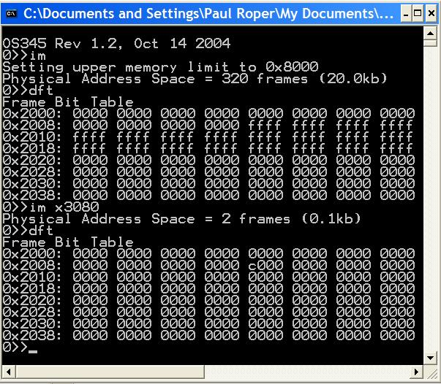
Frame Bit Table
Project 4
0x3000
0x8000
2 Frames

Slide 23
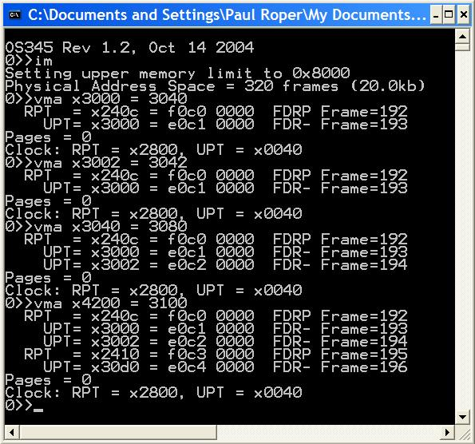
vma
Project 4
2 frames – UPT, Frame
No new frames
Same UPT, new Frame
No swap pages
New UPT, new Frame
Clock did not advance

Slide 24
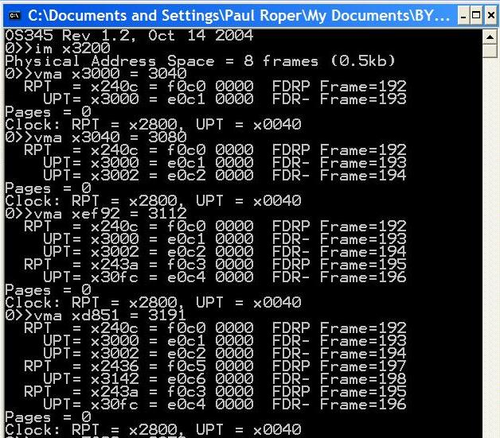
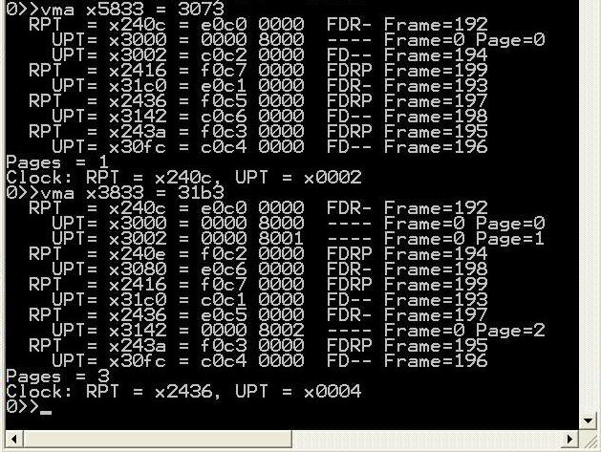
Implementation Demo
Project 4
Notes:
24

Slide 25
unsigned short int *getMemAdr(int va, int rwFlg) { if (va < 0x3000) return &memory[va]; // VM off for system RAM rpta = tcb[curTask].RPT + RPTI(va); // root page table address rpte1 = memory[rpta]; // FDRP__ffffffffff rpte2 = memory[rpta+1]; // S___pppppppppppp if (DEFINED(rpte1)) { // rpte defined } else { // rpte undefined } memory[rpta] = SET_REF(rpte1); // set rpt frame access bit upta = (FRAME(rpte1)<<6) + UPTI(va); // user page table address upte1 = memory[upta]; // FDRP__ffffffffff upte2 = memory[upta+1]; // S___pppppppppppp if (DEFINED(upte1)) { // upte defined } else { // upte undefined } memory[upta] = SET_REF(upte1); // set upt frame access bit // return physical address return &memory[(FRAME(upte1)<<6) + FRAMEOFFSET(va)]; }
Project 4
unsigned short int *getMemAdr(int va, int rwFlg)
Hit!
Fault! Go
get a frame
(frame bit table or run clock)
Notes:
25

Slide 26
accessPage
Project 4
// ********************************************************************************************
// read/write to swap space
int accessPage(int pnum, int frame, int rwnFlg)
{ static unsigned short int swapMemory[LC3_MAX_SWAP_MEMORY];
switch(rwnFlg)
{ case PAGE_GET_ADR: // return page address
{ return (int)(&swapMemory[pnum<<6]);
}
case PAGE_NEW_WRITE: // new write
{ pnum = nextPage++;
}
case PAGE_OLD_WRITE: // write
{ memcpy(&swapMemory[pnum<<6], &memory[frame<<6], 1<<7);
return pnum;
}
case PAGE_READ: // read
{ memcpy(&memory[frame<<6], &swapMemory[pnum<<6], 1<<7);
return pnum;
}
}
return pnum;
}

Slide 28
Virtual Memory Guidelines
Project 4
Verify a clean compilation of your LC-3 virtual memory simulator. Validate that “crawler.hex” and “memtest.hex” programs execute properly.
Modify the getMemAdr() function to handle a 2-level, paging, virtual memory addressing.
Implement a clock page replacement algorithm to pick which frame is unloaded, if necessary, on a page fault.
Use the provided 1MB page swap table routine to simulate paged disk storage (8192 pages) or implement your own routine.
Use crawler.hex and memtest.hex to validate your virtual memory implementation. Use other routines (such as im) to debug you implementation.

Slide 29
Virtual Memory Guidelines
Project 4
Use the following CLI commands to verify and validate your virtual memory system. (Most of these routines are provided, but may require some adaptation to your system.)
dfm <#> Display LC3 memory frame <#>
dft Display frame allocation table
dm <sa>,<ea> Display physical LC3 memory from <sa> to <ea>
dp <#> Display page <#> in swap space
dv <sa>,<ea> Display virtual LC3 memory <sa> to <ea>
im <#> Init LC3/Set upper LC3 memory limit
rpt <#> Display task <#> root page table
upt <p><#> Display task <p> user page table <#>
vma <a> Access <a> and display RPTE’s and UPTE’s
vms Display LC3 statistics

Slide 30
Virtual Memory Guidelines
Project 4
Demonstrate that LC-3 tasks run correctly. Be able to dynamically change LC-3 memory size (im command) and chart resulting changes in page hits/faults. Memory accesses, hits and faults are defined as follows:
Memory access (memAccess) = sum of memory hits (memHits) and memory faults (memPageFaults).
Hit (memHits) = access to task RPT, UPT, or data frame. (Exclude accesses below 0x3000.)
Fault (memPageFaults) = access to a task page that is undefined or not currently in a memory frame.
Page Reads (pageReads) = # pages read from swap space into memory.
Page Writes (pageWrites) = # pages written from memory to swap space.
Swap Page (nextPage) = # of swap space pages currently allocated to swapped pages.
 | Crawler |  |  | Memtest
Frames: | 320 | 16 | 2 | 320 | 16 | 2
Accesses:
Hits:
Faults:
Page Reads:
Page Writes:
Swap Pages:

Slide 31
Project 4 Grading Criteria
Project 4
REQUIRED:
8 pts – Successfully execute crawler and memtest in 20k words (320 frames).
6 pts – Successfully execute crawler and memtest in 1k words (16 frames).
2 pts – Successfully execute 5 or more LC-3 tasks simultaneously in 16 frames of LC-3 memory.
2 pts – Correctly use the dirty bit to only write altered or new memory frames to swap space.
2 pts – Chart and submit the resulting memory access, hit, fault, and swap page statistics after executing crawler (and then memtest) in 320 and 16 frames.
BONUS:
+2 points – early pass-off (at least one day before due date.)
+2 points – Add a per/task frame/swap page recovery mechanism of a terminated task.
+1 point – Implement the advanced clock algorithm (Stallings, pp. 372-373).
+1 point – Implement an additional replacement policy and chart the results.
+2 points – Join the 2-frame club. (Successfully execute 5 or more LC-3 tasks simultaneously in 2 frames of LC-3 memory. Chart the memory accesses, hits, and faults.)
–2 points penalty for each school day late.

Slide 32
So…
Project 4
1. Read and comprehend Stallings, Section 8.1.
2. Comprehend the lab specs. Discuss questions with classmates, the TA’s and/or the professor. Make sure you understand what the requirements are! It's a tragedy to code for 20 hours and then realize you're doing everything wrong.
3. Validate that the demo LC-3 simulator works for a single task with pass-through addressing (virtual equals physical) for the LC-3 by executing the commands “crawler” and “memtest”.
4. Design your MMU. Break the problem down into manageable parts.
5. Create and validate a “clock” mechanism that accesses all global root page tables, user page tables, and data frames.
6. Implement dirty bit last – use “write-through” for all swapping of a data frame to swap space.

Slide 33
So…
Project 4
7. Incrementally add support for the actual translation of virtual addresses to physical addresses with page fault detection as follows:
a. Implement page fault frame replacement using available memory frames only. This should allow you to execute any test program in a full address space.
b. Implement clock page replacement algorithm to unload data frames to swap pages and reload with a new frame or an existing frame from swap space. This should allow you to execute all the test programs in a 32k word address space (20k of paging frames).
c. Implement clock page replacement algorithm to unload User Page Tables when there are no physical data frame references in the UPT. This will be necessary when running in a small physical space (16k words) with multiple tasks.
d. Implement dirty bit to minimize writing frames to swap space.

Slide 34
So…
Project 4
Remember to always increment your clock after finding a replacement frame.
Use the vma function to access a single virtual memory location and then display any non-zero RPT and UPT entries. Implement various levels of debug trace to watch what is going on in your MMU. You may use the provided display functions.
When swapping a user page table to swap space, add some debug “sanity check” code to validate that the UPT does not have any entries with the frame bit set.

Slide 35
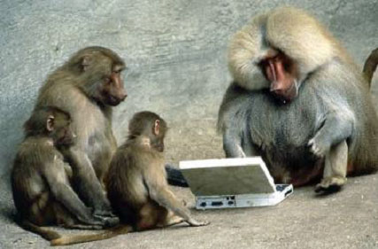
Notes:
Paul Roper
35

